Slide 1
Evaporator Freeze/Thaw Cycle Fixture
Bryan Buccieri
04-10-2023

Slide 2
SS Diagram of Fixture
Valve A
Valve B
Sample 1
Compressor
Valve A
Valve B
Sample 2

Slide 3
SS Diagram of Fixture Direction 1
Valve A
Valve B
Sample 1
Compressor
Valve A
Valve B
Sample 2

Slide 4
SS Diagram of Fixture Direction 2
Valve A
Valve B
Sample 1
Compressor
Valve A
Valve B
Sample 2

Slide 5
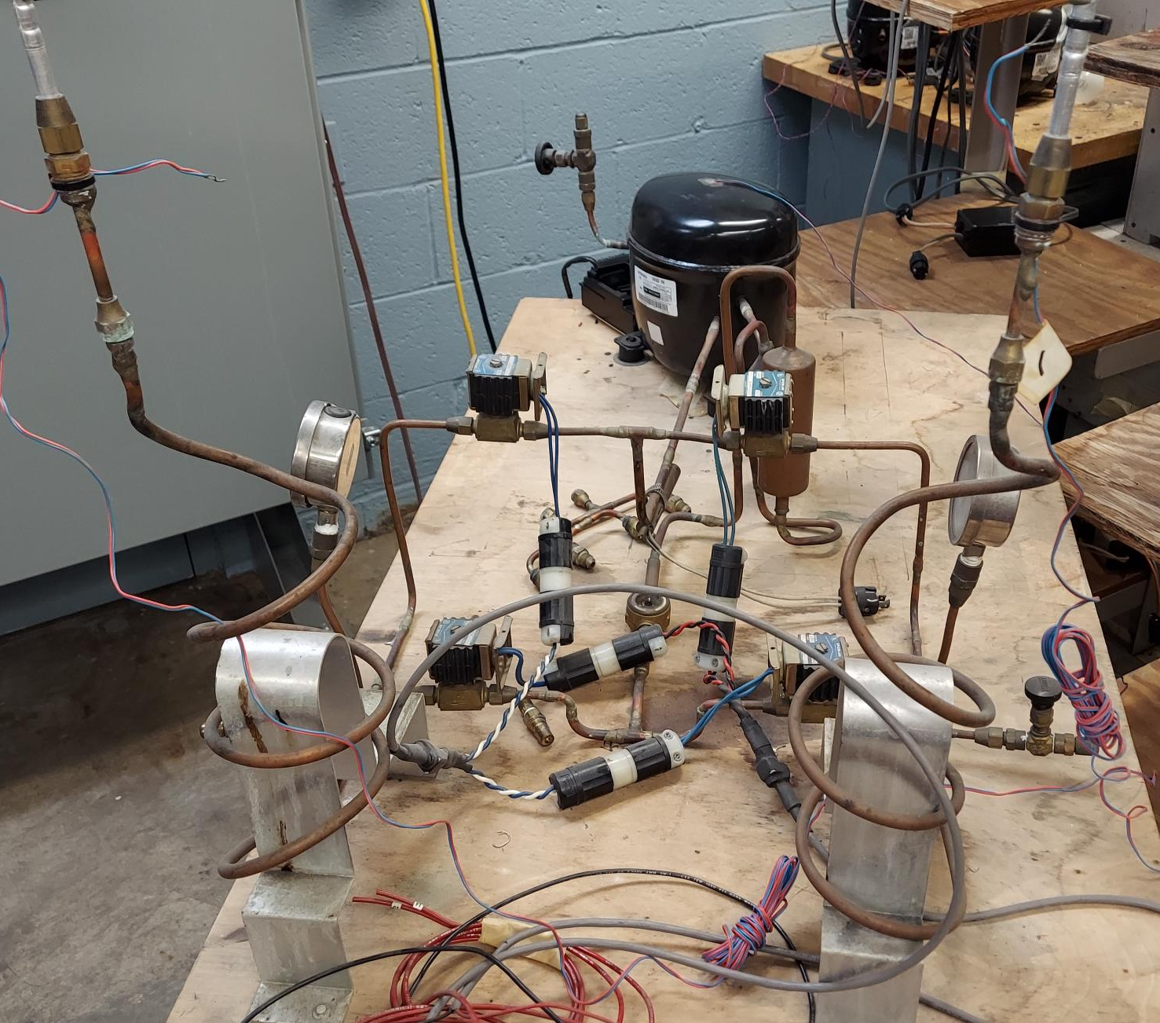

Slide 6
